Slide 1
Chapter 28: Token Economy

Slide 2
Token Economy
What is a Token Economy:
A behavioral program in which individuals or groups can earn tokens for a variety of desired behaviors and can cash in their tokens for back up reinforcers
A token economy consists of
Target behavior(s)
Tokens
Back-up reinforcers

Slide 3
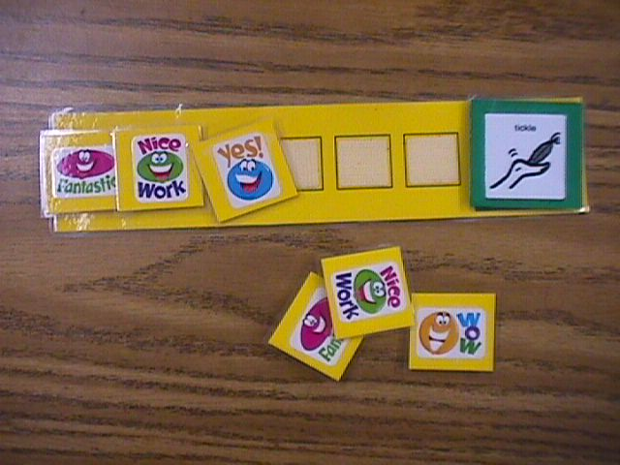
Example of a Token System
Target Behavior: Completed Homework Problems

Slide 4
Step 1: Choose/Define the Target Behavior(s)
Target behaviors are chosen by
The individuals involved (must be behavior that is in their current repertoire)
Social significance (Does it improve their life?)

Slide 5
Step 1: Choose/Define the Target Behavior(s)
Define your target behaviors
Create an operation definition that is:
Observable, measureable and free from ambiguity
Token economies can target multiple behaviors simultaneously (e.g., the behaver can earn tokens for sitting down, completing homework questions, appropriately asking for help)

Slide 6
Step 2: Choose Tokens
Tokens are:
Conditioned reinforcers that can be accumulated and exchanged for back up reinforcers
Tokens are delivered immediately after the occurrence of the target behavior

Slide 7
Step 2: Choose Tokens
Conditioned Reinforcers
A stimulus that gains value following repeated pairings with a reinforcer
Examples:
Stickers/Stamps
Points
Poker Chips

Slide 8
Simple versus Generalized Conditioned Reinforcers
Simple Conditioned Reinforcer
A conditioned reinforcer that is paired with a single backup reinforcer
Examples: Bus tokens or Frequent flyer miles
Subject to satiation
Notes:
When initially implementing a token economy, the system is typically simple and involves a single backup reinforcer (a simple conditioned reinforcer, like tickles in the example). Must employ strategies to avoid satiation.
As the system becomes more complex, you can implement a larger variety of conditioned reinforcers that can be exchanged at different prices at different times. Think prize boxes or arcades. MDa

Slide 9
Simple versus Generalized Conditioned Reinforcers
Generalized conditioned reinforcer
A conditioned reinforcer that is paired with multiple backup reinforcers
Examples: money, praise, gift certificates
Not subject to satiation
Notes:
When initially implementing a token economy, the system is typically simple and involves a single backup reinforcer (a simple conditioned reinforcer, like tickles in the example). Must employ strategies to avoid satiation.
As the system becomes more complex, you can implement a larger variety of conditioned reinforcers that can be exchanged at different prices at different times. Think prize boxes or arcades. MDa

Slide 10
Step 2: Choose Tokens
Tokens should be:
Desirable
Lightweight
Portable
Not easily counterfeited
As the learner becomes more familiar, you can fade out the physical tokens and use marks on a wall or a point system
Notes:
Children and those with developmental disabilities may benefit from coming into contact with physical tokens. They are easy to count and to hold. Over time, the token (stimulus) should be faded out. Perhaps you first utilize physical tokens, then work up to stickers on a wall, then work up to points collected on a data sheet/electronic device. Learners can be trained to monitor their own performance.

Slide 11
Step 3: Choose Back-up Reinforcers
What are back-up reinforcers?
A reinforcer that is given in exchange for a specific number of tokens
Back-up reinforcers should be:
Valuable to the person
Resistant to satiation
Supported by implementers
Notes:
Manipulate MO’s/employ strategies in order to avoid satiation. Discuss prize box in elementary school and how it grew stale over time. Speak about client where you used mystery boxes to conceal prize.

Slide 12
Step 3: Choose Back-up Reinforcers
Select a menu of back-up reinforcers
Use naturally-occurring activities when possible
Privileges
Tangibles/Edibles
Create prices for your back-up reinforcers
Highly preferred items should be more expensive than moderately preferred items.
Notes:
Reinforcers should fade out from contrived/artificial reinforcers to natural/social reinforcers.
If reinforcer is valuable to a leaners programs, make them cheaper. Such as tickets to a dance/concert/social event for someone working on social interactions.

Slide 13
Step 4: Choose Reinforcement Schedule
When will your tokens be delivered?
Intermittent versus continuous
After 1 correct homework problem
After every 3 bites of food
After sitting for an average of 5 minutes
Start out with a short reinforcement schedule, so your learner can come in contact with the contingency and the tokens can become conditioned reinforcers.

Slide 14
Step 4: Choose Reinforcement Schedule
Start out with a short reinforcement schedule, so your learner can come in contact with the contingency and the tokens can become conditioned reinforcers.

Slide 15
Step 5: Exchange
Determine your exchange rate
How many tokens does the learner have to earn to exchange them for the back-up reinforcer?
Considerations:
Individual’s tolerance to delayed reinforcement
Token daily limit
Changes in exchange rate over time
Notes:
Exchange rate should become thinner over time

Slide 16

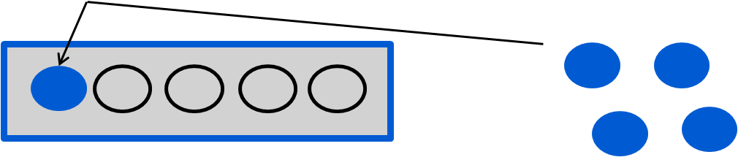
Example: Teaching Lacy to Do Her Homework
For every two homework questions,
Lacy gets a token
If Lacy gain 5 tokens, she gets a snack.

Slide 17
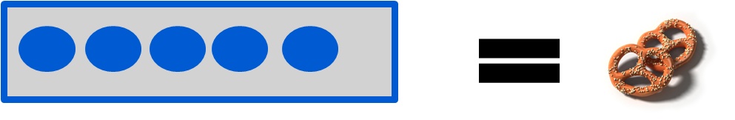
Example: Teaching Lacy to Do Her Homework
Lacy earned 5 tokens
Lacy gets her favorite snack (pretzels)
Notes:
https://www.youtube.com/watch?v=_W-xICvTyHE&t=20s

Slide 18
What if the exchange rate is not met?
Remind the client with a statement about the contingency.
“Remember, you must earn 5 tokens before you can watch TV”
What if the learner states he/she does not want the tokens or back-up reinforcer?
Say “That’s fine”
Reassess token and/or back-up reinforcer quality
Notes:
If you encounter lack of interest/non compliance, that usually means that the MO is not in place for the backup reinforcer or there is a ratio strain (may need to work back down and reassess exchange rate)

Slide 19
Example of a poor token economy
https://www.youtube.com/watch?v=3IYQXUfezxY&t=1s
What went wrong?

Slide 20
Response Cost
What is response cost?
A negative punishment procedure
Removal of a token contingent on problem behavior which delays access to the back-up reinforcer
Notes:
Feeding client

Slide 21
Response Cost
When to use response cost:
After token economy is in use
When there is competing behavior
Greater fines for more severe problem behavior
Notes:
Feeding client

Slide 22
Response Cost
Considerations:
The learner should know how many tokens will be removed
Learner should lose some, but not all of their tokens
The removal should be immediate
Notes:
Feeding client

Slide 23

Example of Response Cost

Slide 24


Example of Response Cost
Notes:
https://www.youtube.com/watch?v=9ql1l45NZvQ&t=9s
30 seconds in

Slide 25
Analyzing a Response Cost
Johnny earns tokens for completion of his homework. One day, while they were shopping at the store, Mom told Johnny that when she gets home she is going to remove stickers because he: cried, ran off in the store, and picked up a chocolate bar when he was told not to.
What is wrong with this example?
Loss of tokens = not specified
Removal/earning = not immediate
Possibly removed all
Notes:
Didn’t specify how many
Punishment is delayed
Unrelated to target behavior

Slide 26


Review: Important Assets to a Token Economy
When implementing a token economy, deliver tokens immediately
Pair praise with the delivery of tokens
Plan to fade out tokens to less artificial things
Poker chips → check marks → praise

Slide 27
Advantages of Using a Token Economy
Tokens help bridge the gap between the behavior and the back-up reinforcer
Strength of the token does not depend on specific motivating operations when implemented correctly

Slide 28
Advantages of Using a Token Economy
Learner can save tokens for a “bigger prize” (delay tolerance)
Allows for a wide range of target behaviors
Flexibility
Uses a variety of contingencies

Slide 29
Disadvantages of Using a Token Economy
Takes time to implement, requires multiple aids, and is complex
Costly depending on your back-up reinforcers

Slide 30
Example of a successful token economy
https://www.youtube.com/watch?v=lQYzT49hyKo
What went right?

